Slide 1
CS 65500 Advanced Cryptography
Lecture 1: Indistinguishability
Instructor: Aarushi Goel
Spring 2025

Slide 2









Slide 3







Slide 4






Slide 5








Slide 6














Slide 7










Slide 8

















Slide 9















Slide 10












Slide 11













Slide 12










Slide 13












Slide 14
























Slide 15




















Slide 16

















Slide 17
















Slide 18














Slide 19
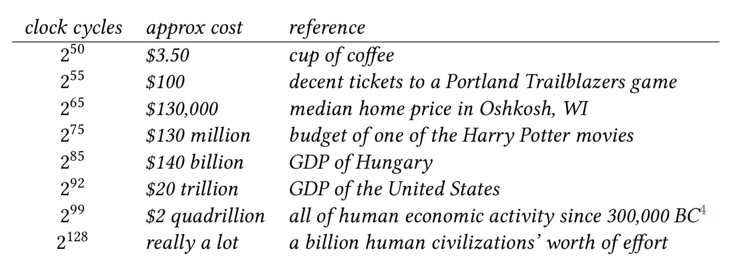









Slide 20
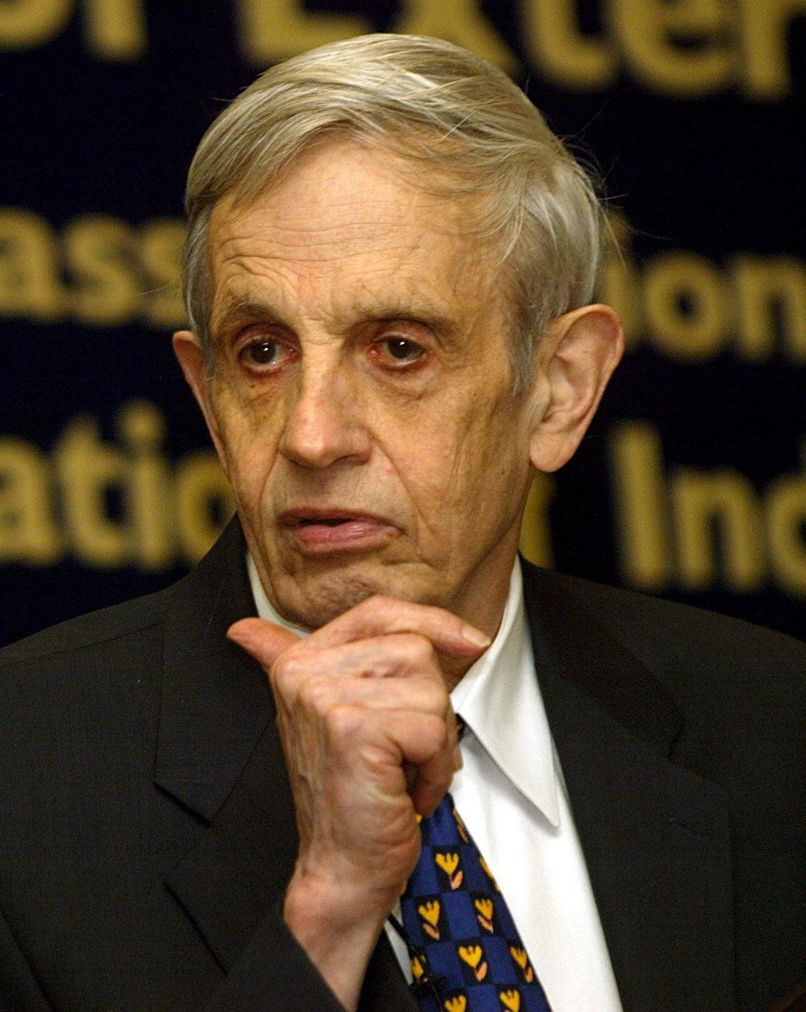













Slide 21


















Slide 22
